Slide 1

Project Title: 6Stars Shopping Mall Data Analysis
Unlocking Insights for Growth & Profitability
Website: www.Rabtechanalytics.com
Phone number:+2348035675760
E-mailAddress: emailrabtechanalytics.com

Slide 2
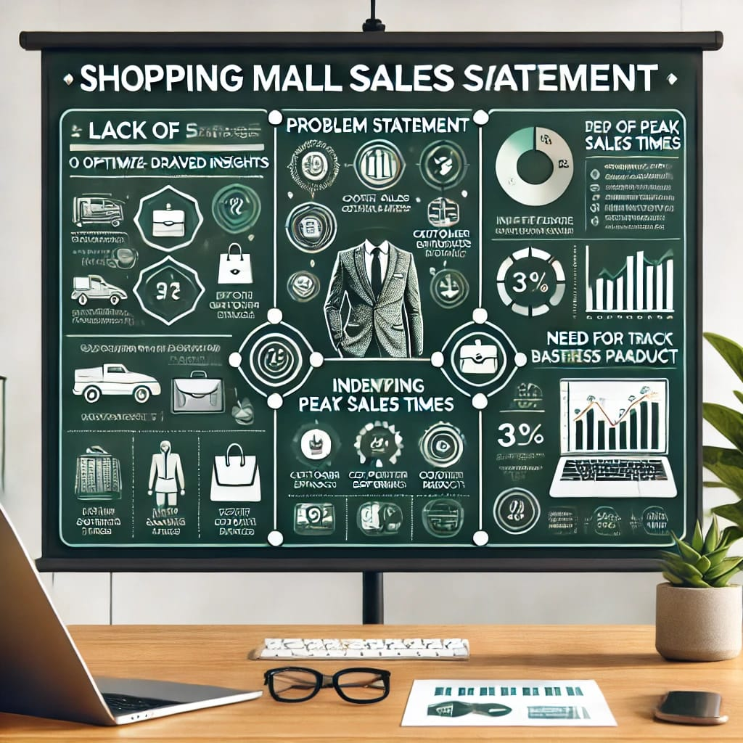
Problem Statement
Lack of data driven insights to:
*optimize sales
*improve customer experience
*enhance revenue generation
In efficiency in identifying :
-peak sales time
-top performing product
-Customer preference
Need for centralized dashboard to track business performance

Slide 3
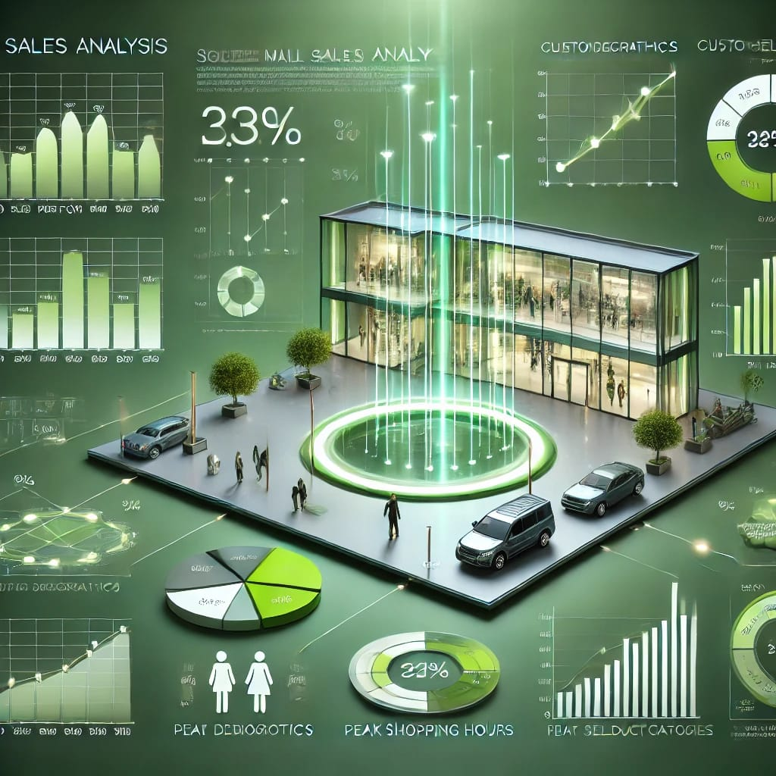
Solution
A comprehensive Excel-based data analysis using pivot tables, dashboards, and key performance indicators (KPIs).
Identifying top-selling products, revenue distribution, and peak sales periods.
Implementing visual dashboards for better decision-making.

Slide 4
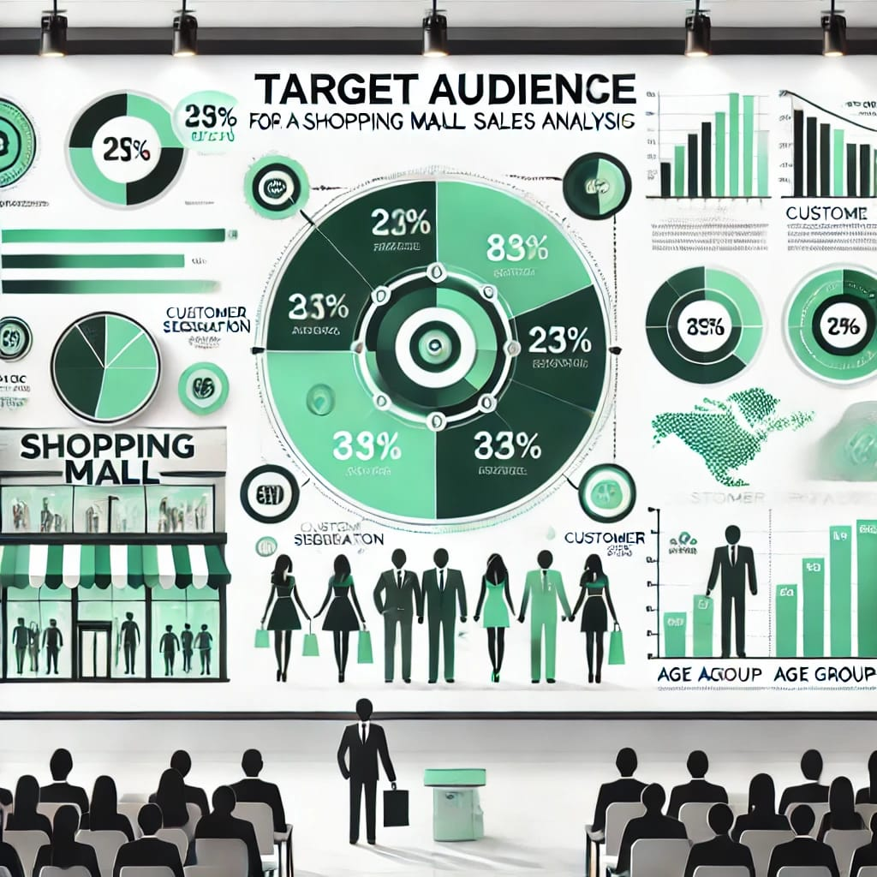
Investors and business analysts
Retail store owners
Management and stakeholders

Slide 5
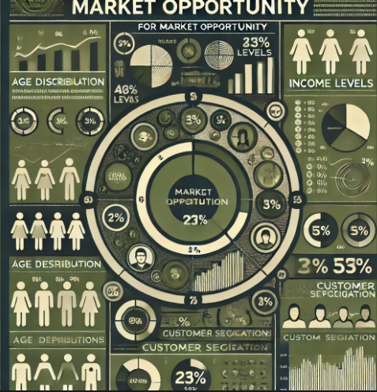
Market Opportunity
Growing demand for data-driven decision-making in retail.
Potential for increased revenue through optimized inventory management and targeted marketing.
Enhancing customer experience to drive repeat visits and higher spending.

Slide 6
How to Make Money
Implement targeted promotions based on peak sales analysis.
Optimize product placements to highlight top-performing items.
Offer data-driven consulting services to retailers within the mall.

Slide 7
Key Features
Interactive Dashboard: Displays real-time insights on revenue, sales trends, and customer preferences.
Pivot Table Analysis: Enables quick data summarization for sales trends.
Slicers & Filters: Allow easy customization of reports by date, branch, and product categories.
Graphical Reports: Visual representation of data for better decision-making.

Slide 8
DEMO

Slide 9
If you're interested in transforming data into actionable insights for smarter decision-making, feel free to reach out to us at Rabtech Analytics."
Website: www.Rabtechanalytics.com
📞 Phone :+2348035675760
📧 E-mail: emailrabtechanalytics.com

